Slide 1




CODE COMMANDOS
HACKTOBERFEST 1.0

Slide 2


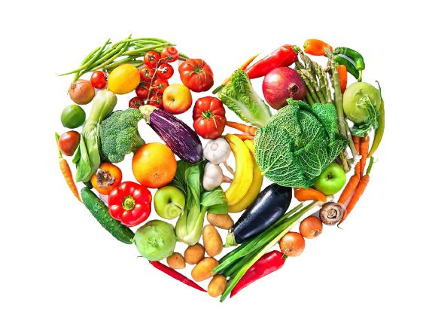
Problem statement
Now-a-days being healthy is becoming major issue .And the main cause of helath problem is improper nutrition. Intake of Calories are essential for human health. The key is consuming the right amount.Everyone requires different amounts of energy each day, depending on age, sex, size, and activity level.Foods high in energy but low in nutritional value provide empty calories.

Slide 3





Solution
To overcome this problem we brought up with a dietary management website to adress the necessity of effective calorie intake and recommend good food time to time basis. This web will help us understand the importance of health and recommend to have food based on your dietary plan

Slide 4



Key Features and Functionality
<!DOCTYPE html><html lang="en"><head> <meta charset="UTF-8"> <meta name="viewport" content="width=device-width, initial-scale=1.0"> <title>Calorie Tracker</title> <link rel="stylesheet" href="styles.css"> <!-- You'd need to create a CSS file for styling --></head><body> <header> <h1>Calorie Tracker</h1> </header> <section id="calorie-entry"> <h2>Log Your Calories</h2> <input type="text" id="food-name" placeholder="Food Name"> <input type="number" id="food-quantity" placeholder="Quantity (g)"> <button id="add-food-button">Add Food</button> </section> <section id="daily-intake"> <h2>Your Daily Intake</h2> <ul id="intake-list"> <!-- Food items and quantities will be dynamically added here using JavaScript --> </ul> </section> <section id="total-calories"> <h2>Total Calories</h2> <p id="total-calories-count">0</p> </section> <script src="app.js"></script> <!-- You'd need to create a JavaScript file for functionality --></body></html>

Slide 5


Social impact
Social influences on eating are powerful and pervasive. Social norms may play a role in the development and maintenance of obesity. Social eating norms may be targeted to encourage healthier eating.
This web helps us to understand the basic importance of diet management in our busy schedule and remind us to take healthy food on time

Slide 6
Revenue Model
While the concept of wellness has been around for a long time, the outbreak of the COVID-19 pandemic forced many consumers to transform themselves to adopt a healthy lifestyle. As a result, consumers are increasingly taking their health into their own hands and started using fitness apps to track their physical condition to help them change their daily activities and diet plans.

Slide 7





Technologies Used
OUR TEAM UTILIZED A VARIETY OF TECHNOLOGIES INCLUDING PROGRAMMING LANGUAGE
HTML, ONLINE COMPILER,
GITHUB AND ONLINE REFERENCES.

Slide 8

The Team
M. Bhargavi
Md. Gohar
T. Sai Sravan
22MIS7129
22BCE8838
22BCE7320

Slide 9


Thank You
HACKTOBER FEST

